Slide 1
Standardized Test untuk Admission di US

Slide 2
Andreas Febrian

Slide 3
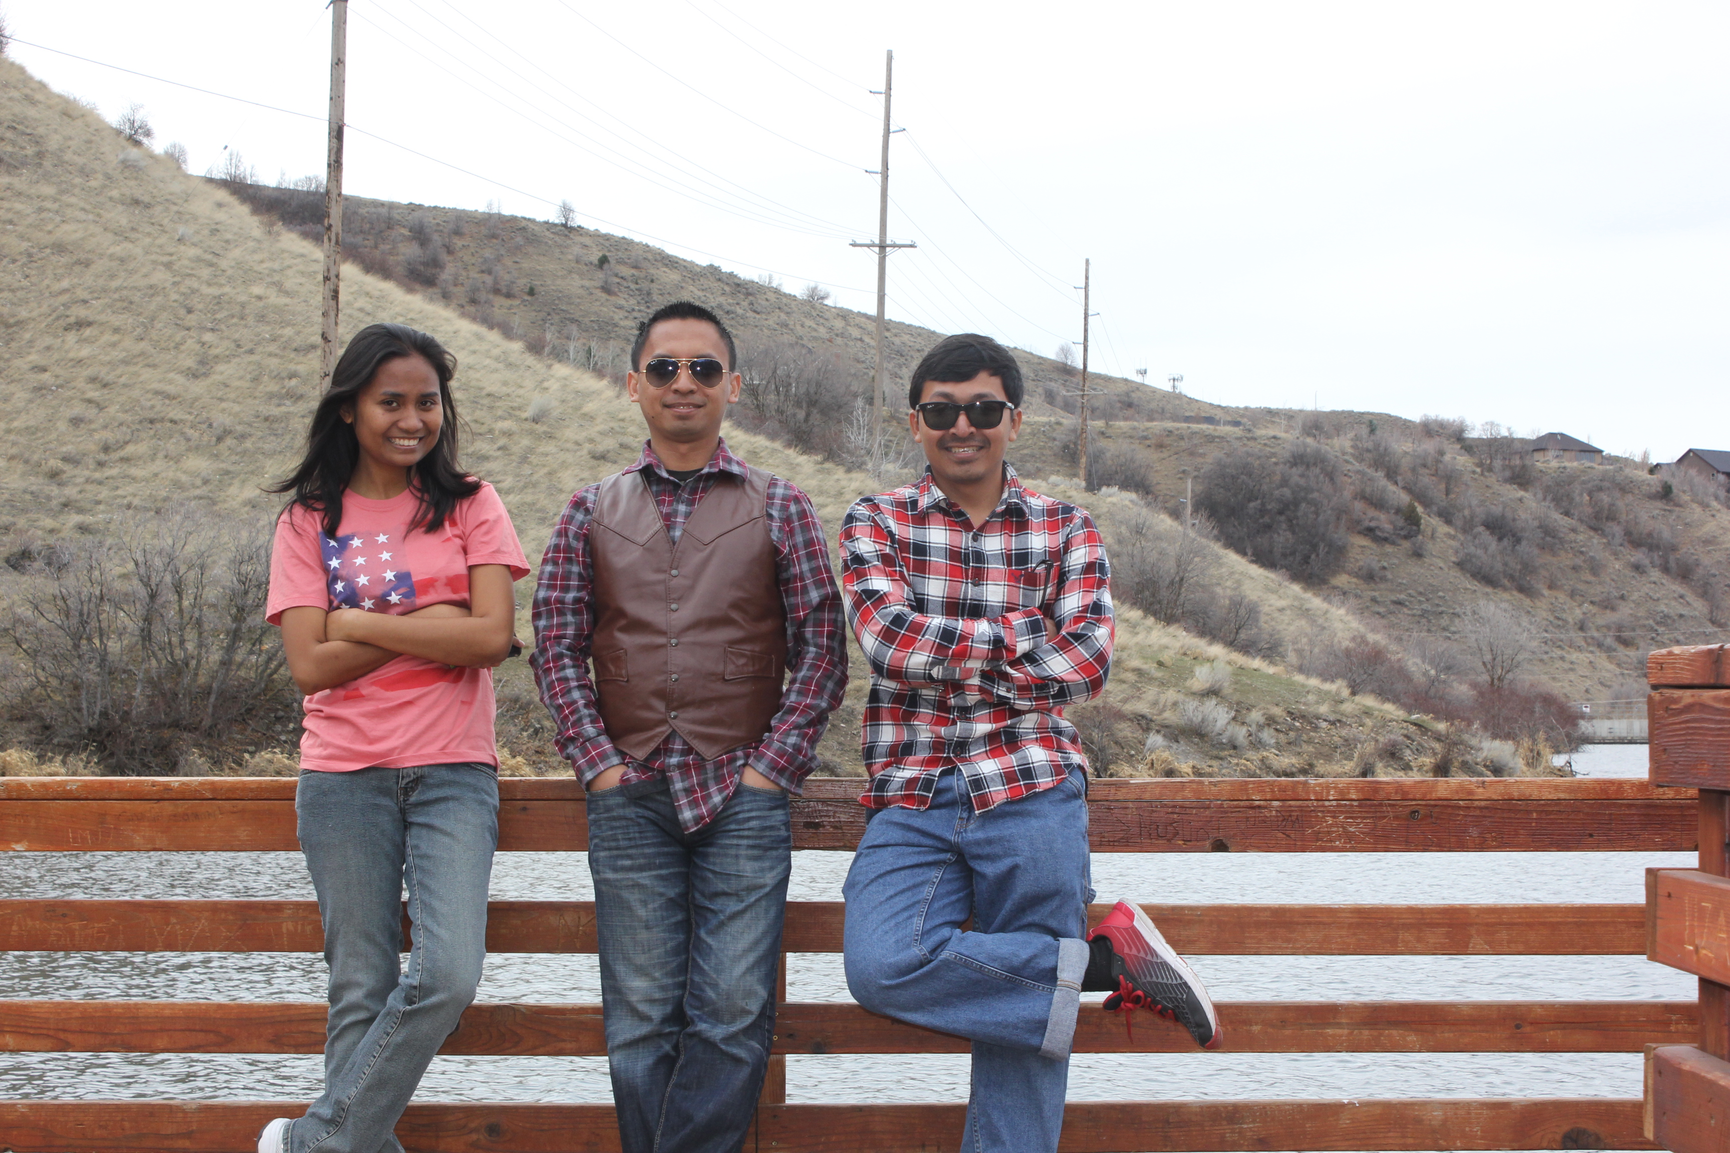
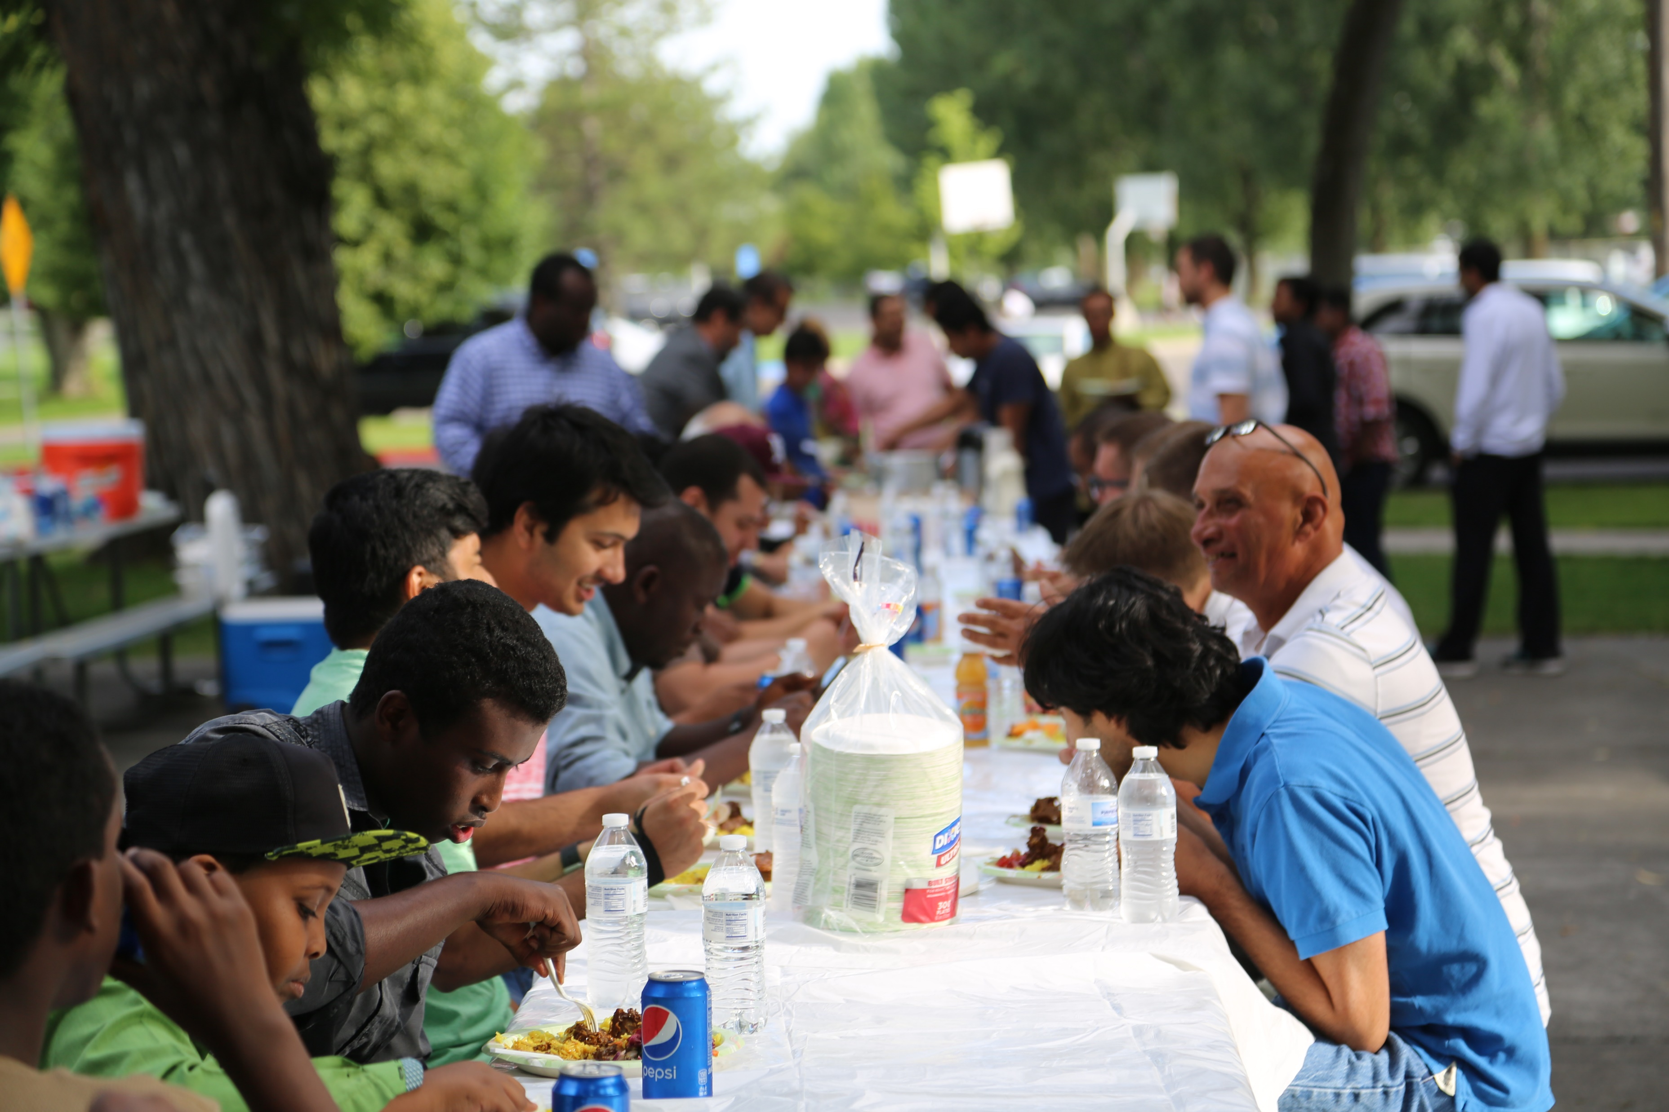
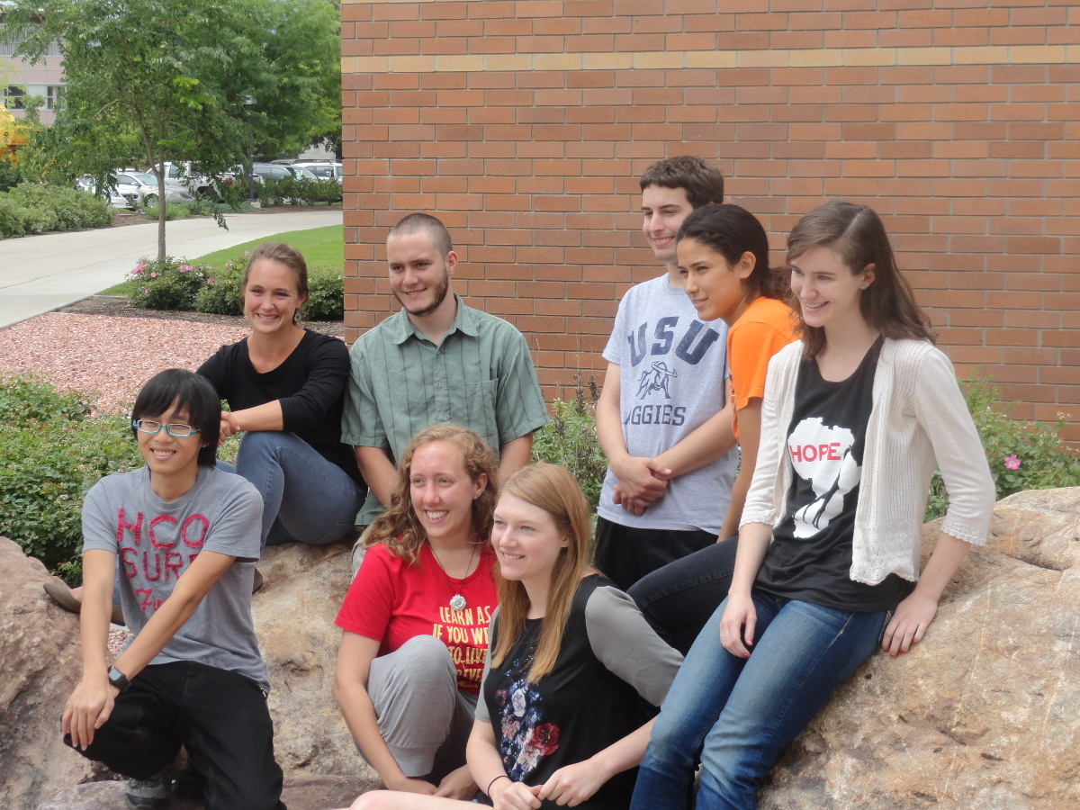
Pameran

Slide 4
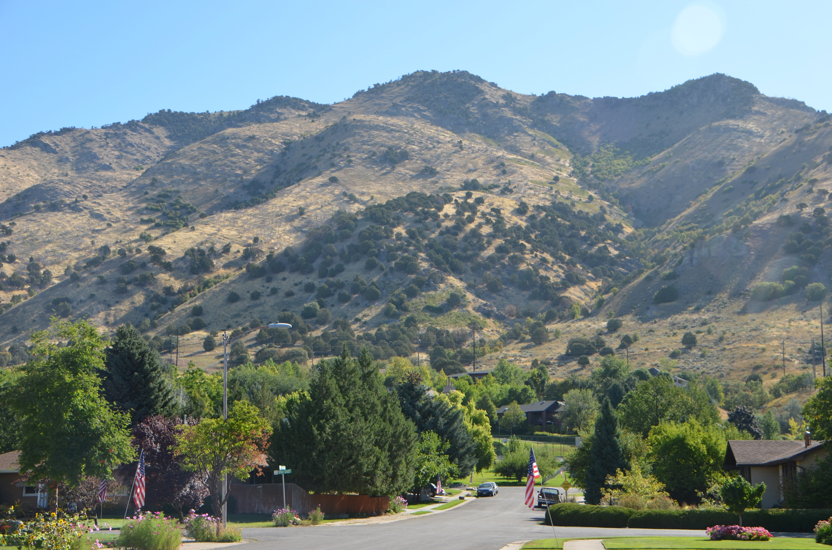
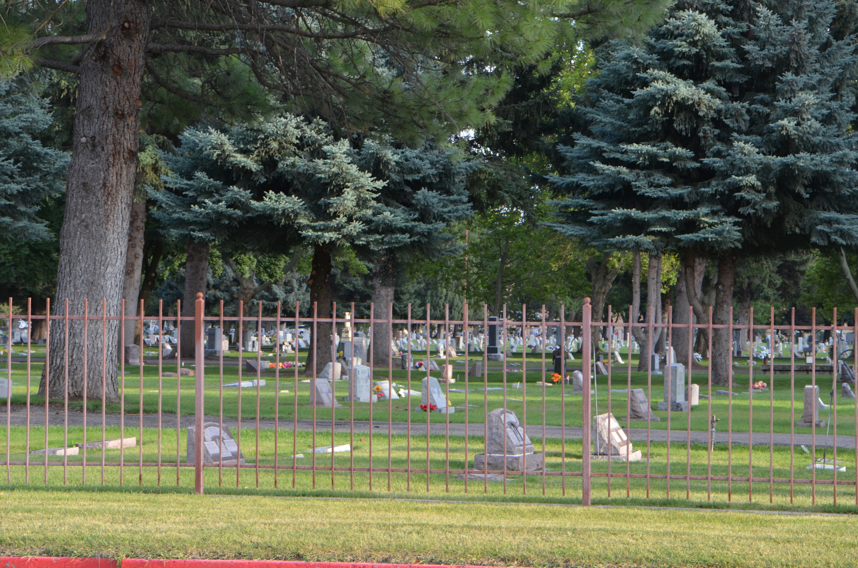
Pameran

Slide 5
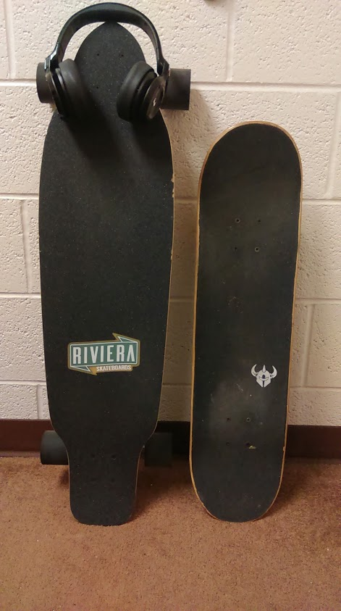
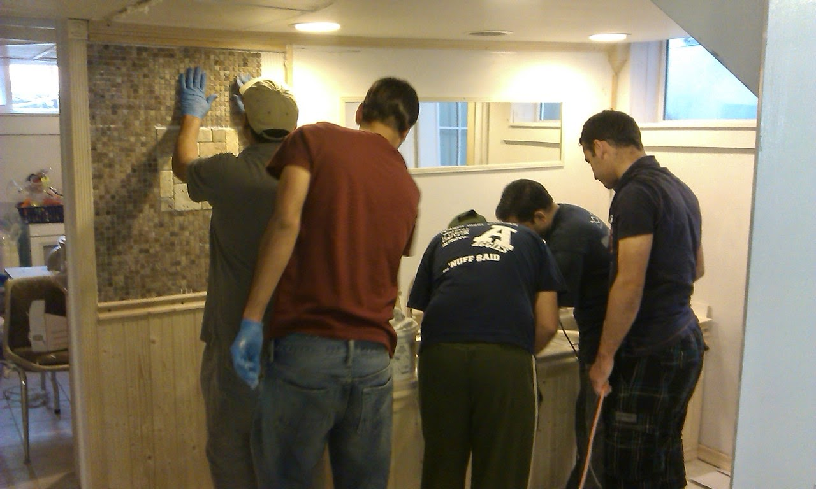
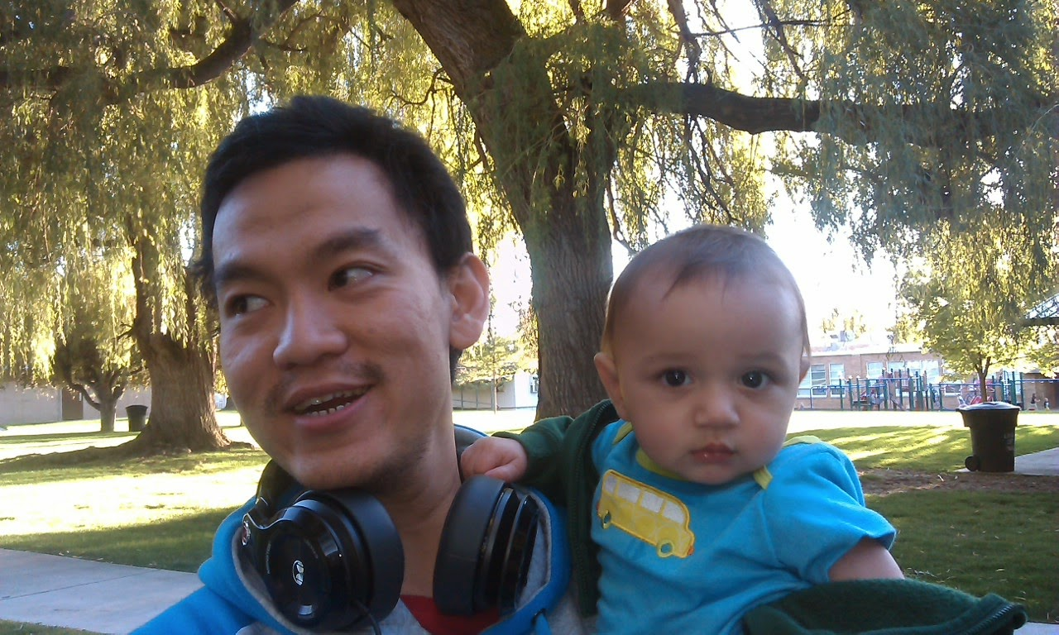
Pameran

Slide 6
Standardized Test
Tentang GRE
Strategi Sukses

Slide 7
Standardized Test
Ujian yang dilakukan dengan (1) komposisi dan tingkat kesulitan soal yang sama; dan (2) prosedur pengerjaan, pengawasan, dan penilaian yang sama.
Image: https://solo.tribunnews.com/

Slide 8
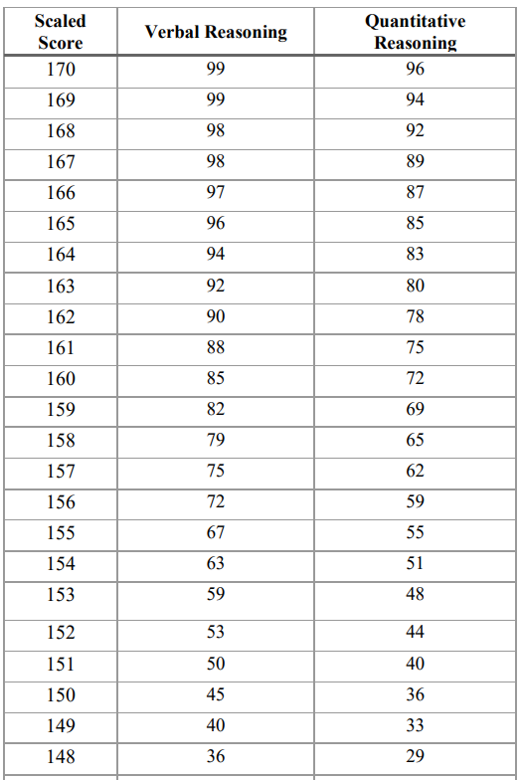
Aplikasi
Verbal Reasoning Measure
157

Slide 9
Beberapa Tes Standar
undergraduate
Scholastic Assessment Test
American College Testing
Law School
Admission Test
graduate
Graduate Record
Examination
Graduate Management
Admissions Test

Slide 10
Graduate Record Examination
The GRE is owned and administered by Educational Testing Service. https://www.ets.org/gre/revised_general/prepare/

Slide 11
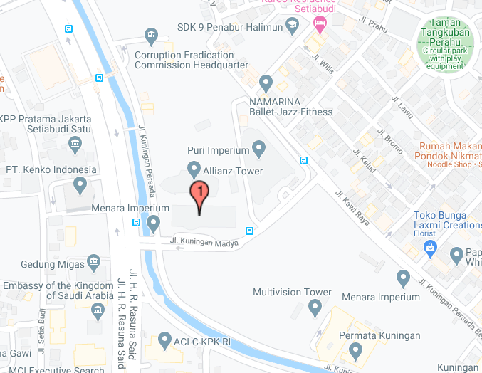
Prosedur Tes
Mendaftar secara online di https://www.ets.org/gre
Bayar $205
Datang ke tempat tes; contoh: Menara Imperium, Jakarta
Kerjakan ujian
Hasil ujian akan dikirimkan langsung ke Lembaga/Institusi yang kamu pilih

Slide 12
GRE Tests
Ada dua jenis tes GRE:
General
Subject
Analytical Writing
Verbal Reasoning
Quantitative Reasoning
Biology
Chemistry
Literature in English
Mathematics
Physics
Psychology

Slide 13
GRE Tests
Analytical Writing
Verbal Reasoning
Quantitative Reasoning
Menguji kemampuan untuk mengemukakan dan mendukung sebuah ide kompleks, membuat dan mengevaluasi argumen, dan membuat pembahasan yang fokus dan koheren.
Menguji kemampuan analisa dan evaluasi materi tertulis, sintesa informasi yang diperoleh, dan menganalisis hubungan antar komponen, konsep, dan kata dalam tulisan.
Menguji kemampuan dan konsep dasar matematika, dan membangun argumen, memodelkan, dan menyelesaikan masalah dengan menggunakan pendekatan kuantitatif.

Slide 14
Analytical Writing
Analyze an Issue
Analyze an Argument
Evaluasi isu yang diberikan dan kompleksitasnya, ambil posisi terhadap isu (i.e., setuju atau tidak setuju), dan tuliskan argumen, alasan, dan contoh untuk mendukung posisi tersebut.
Waktu: 30 menit
Evaluasi argumen yang diberikan, kemudian analisis logical soundness (premis memiliki nilai kebenaran dan kesimpulannya valid) dari argumen tersebut, dan tuliskan. Ini bukan mengenai posisi yang kita pilih.
Waktu: 30 menit

Slide 15
Verbal Reasoning
Reading Comprehension
Text Completion
Sentence Equivalence
Designed to test a wide range of abilities that are required in order to read and understand the kinds of prose commonly encountered in graduate school.
Skilled readers maintain a constant attitude of interpretation and evaluation, reasoning from what they have read so far to create a picture of the whole and revising that picture as they go.
test the ability to reach a conclusion about how a passage should be completed on the basis of partial information, but to a greater extent they focus on the meaning of the completed whole.

Slide 16
Quantitative Reasoning
Arithmetic
Algebra
Topics include properties and types of integers, such as divisibility, factorization, prime numbers, remainders and odd and even integers; arithmetic operations, exponents and roots; and concepts such as estimation, percent, ratio, rate, absolute value, the number line, decimal representation and sequences of numbers.
Topics include operations with exponents; factoring and simplifying algebraic expressions; relations, functions, equations and inequalities; solving linear and quadratic equations and inequalities; solving simultaneous equations and inequalities; setting up equations to solve word problems; and coordinate geometry, including graphs of functions, equations and inequalities, intercepts and slopes of lines.
Geometry
Data Analysis
Topics include parallel and perpendicular lines, circles, triangles — including isosceles, equilateral and 30°-60°-90° triangles — quadrilaterals, other polygons, congruent and similar figures, three-dimensional figures, area, perimeter, volume, the Pythagorean theorem and angle measurement in degrees. The ability to construct proofs is not tested.
topics include basic descriptive statistics, such as mean, median, mode, range, standard deviation, interquartile range, quartiles and percentiles; interpretation of data in tables and graphs, such as line graphs, bar graphs, circle graphs, boxplots, scatterplots and frequency distributions; elementary probability, such as probabilities of compound events and independent events; conditional probability; random variables and probability distributions, including normal distributions; and counting methods, such as combinations, permutations and Venn diagrams.

Slide 17
Vocabulary
Vocabulary yang digunakan dalam GRE jauh lebih banyak dan lebih tidak umum jika dibandingkan dengan yang digunakan pada TOEFL dan IELTS; contoh:
Vitiate: verb, Destroy or impair the legal validity of
Synonyms: put an end to, do away with, scrap
“The firm admitted that it vitiated its stated standards for evaluating securities in an area where those standards put in question its ability to win business.”
Source: https://gre.economist.com/gre-advice/gre-vocabulary/which-words-study/most-common-gre-vocabulary-list-organized-difficulty

Slide 18
Strategi Sukses
Lakukan hal berikut agar kamu bisa bernyanyi bahagia ketika mengambil tes!

Slide 19
Luruskan Niat
Apa yang kamu inginkan?
Kenapa kamu ingin itu?
Seperti apa kondisi saat ini?
Apakah mimpi itu layak dikejar?
Apa saja kekurangnya kamu?
Apakah siap kerja keras?
Apakah support system ada?
Image: https://yogapermanawijaya.wordpress.com/

Slide 20
Believe in Yourself
Image: https://www.komar.de/

Slide 21
Rajin Membaca
Image: https://www.shutterstock.com/
read… read… and read…
read… read… and read…
read… read… and read…

Slide 22
Tambah Konteks
Question Bank
Pertanyaan yang diberikan akan mengangkat isu umum, termasuk isu di dunia, isu di Amerika, dan budaya di Amerika.
Banyak mengekspose diri sendiri terhadap budaya lain, melalui berita, film, buku, video, dan lainnya.
2018 Test
2019
Test
2020
Test

Slide 23
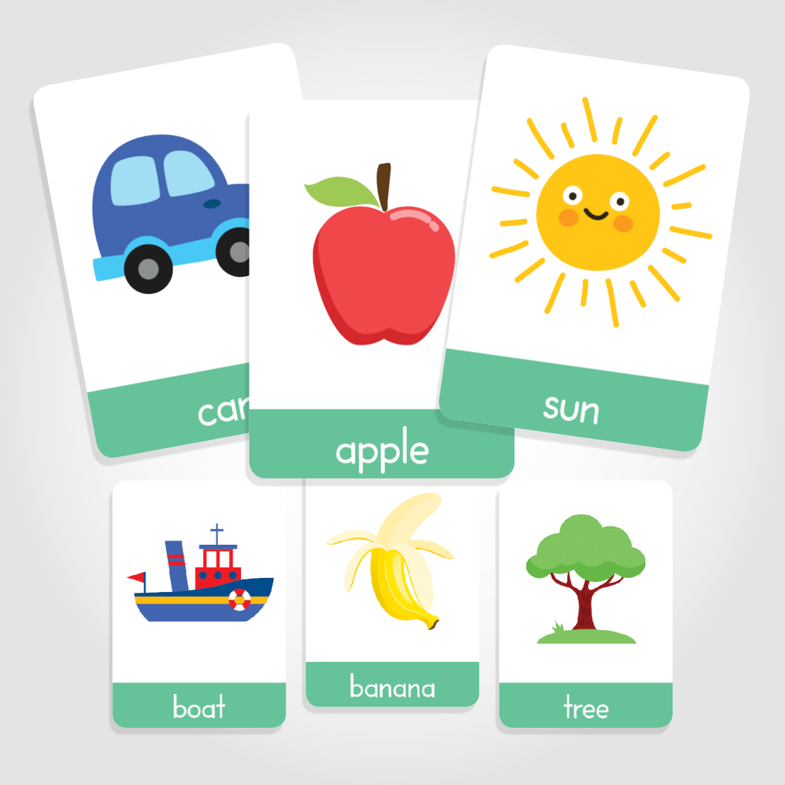
Tambah Vocabulary
Flash card!!!
Menulis dan berbicara dengan Bahasa Inggris!
Anything that you think will work!

Slide 24
Budaya Eksplisit
Implisit
Eksplisit
kesal | marah | sedih | kecewa
benci | bosan | jenuh iri | dengki | cemburu
Image: https://bundafaizfathilabib.wordpress.com/

Slide 25
Merapihkan Ide
Grammar
Menggabungkan agar alurnya jelas, tepat sasaran, dan tidak membingungkan tidaklah mudah, khususnya karena kurang dilatih.
Image: https://icons8.com/

Slide 26
Find a Mentor

Slide 27
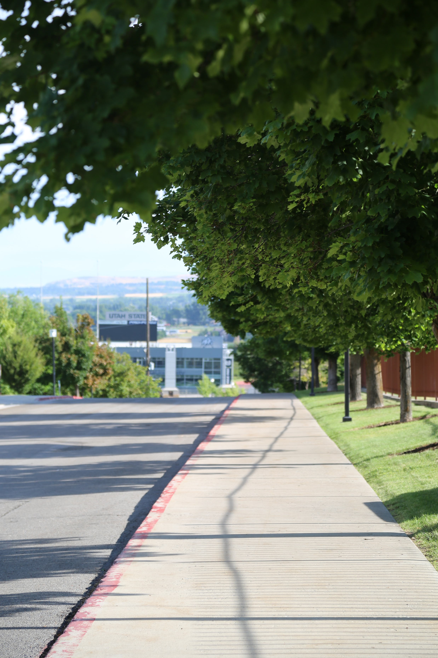
Enjoy the process!
The result will follow!

Slide 29
Acknowledgement
Andreas Febrian
Andreas Febrian

